Slide 1
Embedded C program for interfacing a dual 7-segment LED with increment and decrement switch

Slide 2
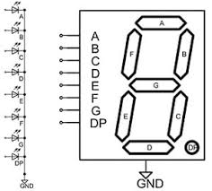
Algorithm
Read the status of the switch.
If the status of switch is changed, increment the count on seven segment display.
Display the ones and tens place digit separately on 2 seven segment displays.
There are 2 types of 7 segment LED’s, here we are using common Cathode type

Slide 3
Defining combinations of ABCDEFG for different integers.
Integer | a | b | c | d | e | f | g | Hex (abcdefg)
0 | 1 | 1 | 1 | 1 | 1 | 1 | 0 | 0x3F
1 | 0 | 1 | 1 | 0 | 0 | 0 | 0 | 0x06
2 | 1 | 1 | 0 | 1 | 1 | 0 | 1 | 0x5B
3 | 1 | 1 | 1 | 1 | 0 | 0 | 1 | 0x4F
4 | 0 | 1 | 1 | 0 | 0 | 1 | 1 | 0x66
5 | 1 | 0 | 1 | 1 | 0 | 1 | 1 | 0x6D
6 | 1 | 0 | 1 | 1 | 1 | 1 | 1 | 0x7D
7 | 1 | 1 | 1 | 0 | 0 | 0 | 0 | 0x07
8 | 1 | 1 | 1 | 1 | 1 | 1 | 1 | 0x7F
9 | 1 | 1 | 1 | 1 | 0 | 1 | 1 | 0x6F

Slide 4
Steps for programming STM32
Enable clock for necessary ports.
Reset the GPIO’s that are to be used.
Configure the GPIO’s for input/ output.
Reset the PUPDR register for necessary pins.
Configure the necessary pins for PULL UP/ PULL DOWN with PUPDR.
Initialize a variable named “count” with “0”.
Read necessary IDR value.
Increment the count value and actuate peripherals by configuring necessary ODR’s to display the count value on both the displays.

Slide 5
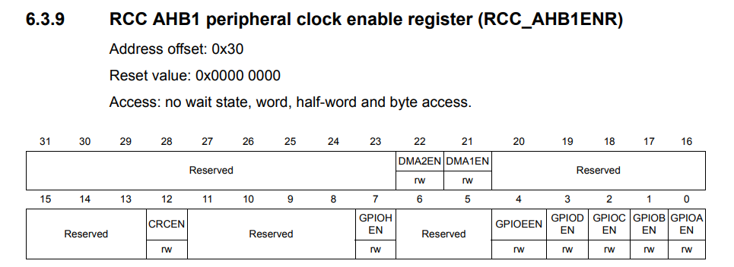
Enabling Clock
RCC->AHB1ENR = 0X00000001;
Let us use GPIOA for all the operations.

Slide 6
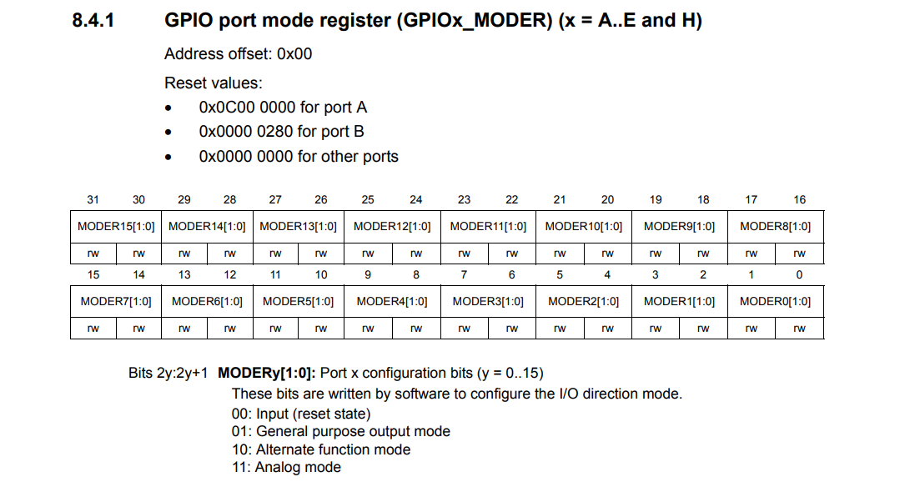

Slide 7
How to Write a value into a register?
GPIOA->MODER = 0X00000001; //which means PA.0 is output
Now if I want PA.3 to be as output then
GPIOA->MODER = 0X00000040;
This will configure PA.3 as output but remove the previous configuration of PA.0.
Instead we can use “&=~” combination read as “and assigned with negation of” to reset necessary ports.
We can use “|=“ combination read as “or assigned with” to configure to required mode.

Slide 8
How to Write a value into a register?
Objective: make PA.0 to PA.13 as outputs PA.15 as input.
Steps:
Reset the MODER register of port A pertaining to PA.0 to PA.6 and PA.8.
A moder state of “00” for a particular pin is assumed to be the reset state.
GPIOA->MODER&=~0XFFFFFFFF;
Configure the MODER register of port A for PA.0 to PA.13 as outputs PA.15 as input.
“01” for a pin is treated as output.
“00” for a pin is treated as input.
GPIOA->MODER |= 0x05555555;;

Slide 9
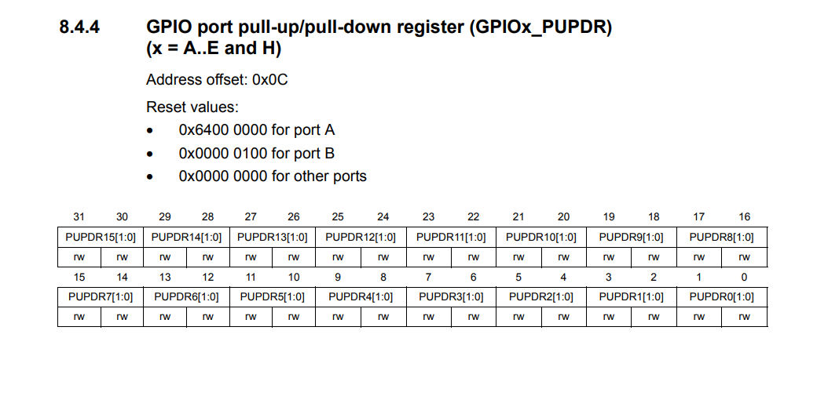

Slide 10
Configuring pull up and pull down registers
Why should I configure PUPDR?
When I don’t press the switch, the default value of the switch is depended on whether the pin is pulled up or pulled down.
What are the default values?
Pulled up pin: Default value is “0”.
Pulled down pin: Default value is “1”.
“00” is for No pull up No pull down
“01” is for Pull-Up
“10” is for Pull-Down
“11” is Reserved
Reset PUPDR
GPIOA->PUPDR&=~0xF0000000;
Configure PUPDR
GPIOA->PUPDR|=0X50000000
Let us assume “count = 0”

Slide 11
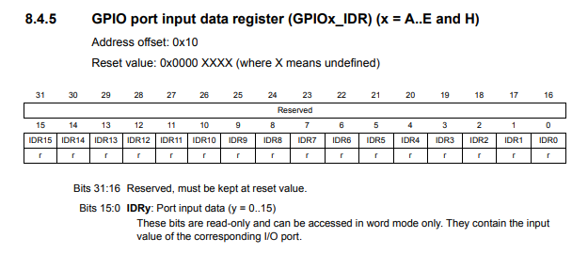
Monitoring IDR
Read data from IDR
First construct the monitoring bit, here IDR1 must be 1 to monitor the state of IDR1 we have to perform bitwise and with IDR register
GPIOA->IDR & 0X0008000, GPIOA->IDR & 0X0004000; These will read the status of the 2 particular Pins through IDR

Slide 12
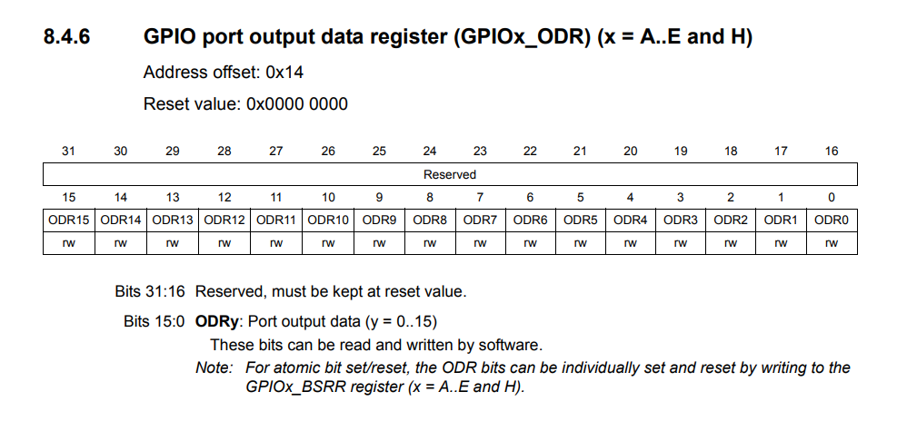
Configuring ODR
Initialize an array with the digit wise hex codes.
num[10]={0X3F,0X06,0X5B,0X4F,0X66,0X6D,0X7D,0X07,0X7F,0X6F};
Increment the count if status of the pin1 is changed, Decrement the count if status of the pin1 is changed, don’t increment or decrement while pressed, increment or decrement only when released.
Now configure the ODR by the necessary hex code.
GPIOA->ODR=num[(count/10)%10]<<7 | num[count%10];
This will shift the tens place digit to upper nibble, keeping ones place to lower nibble

Slide 13
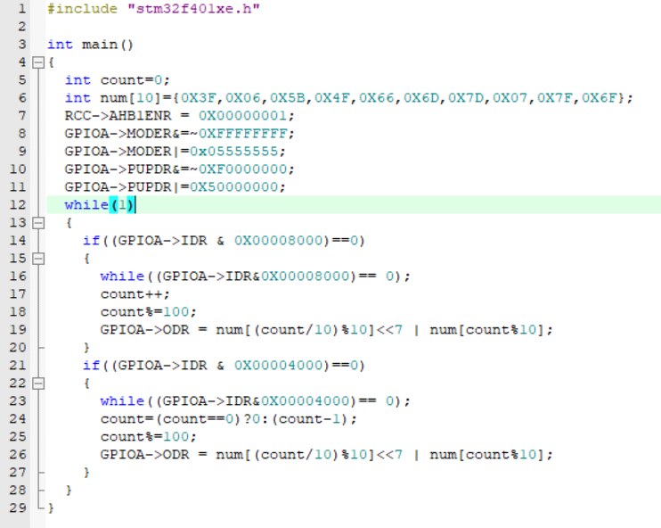
Final Code

Slide 14

Please Subscribe to my channel……..
Like Share Comment Subscribe

